Slide 1
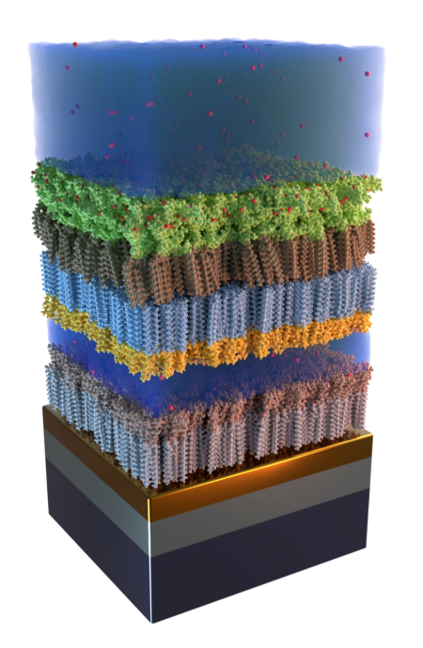
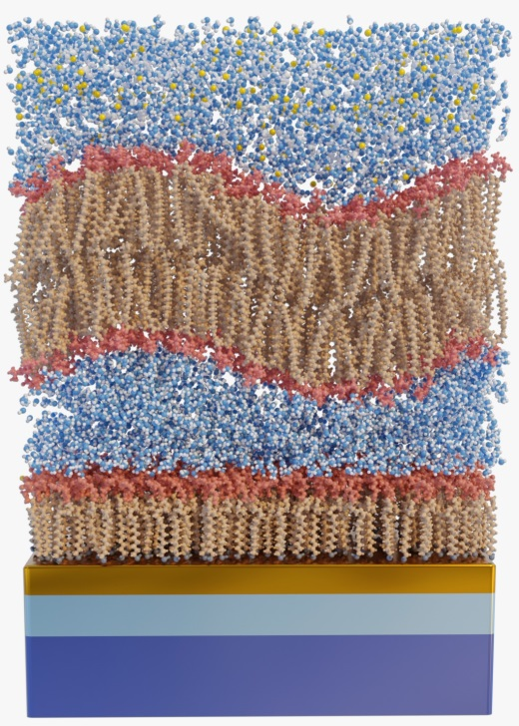
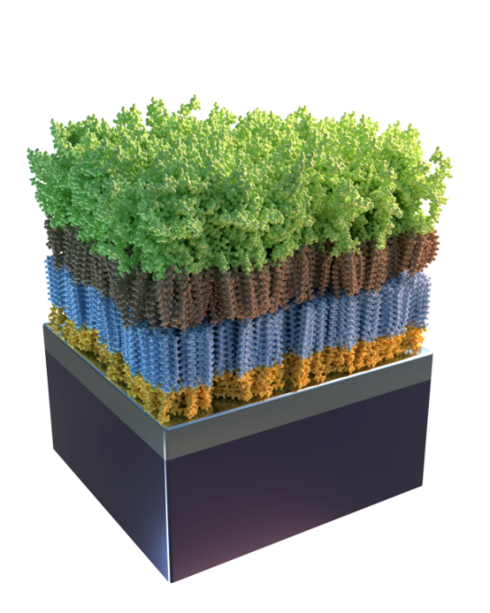
Examining Complex Membrane Structures with Neutrons
Luke Clifton
luke.clifton@stfc.ac.uk

Slide 2
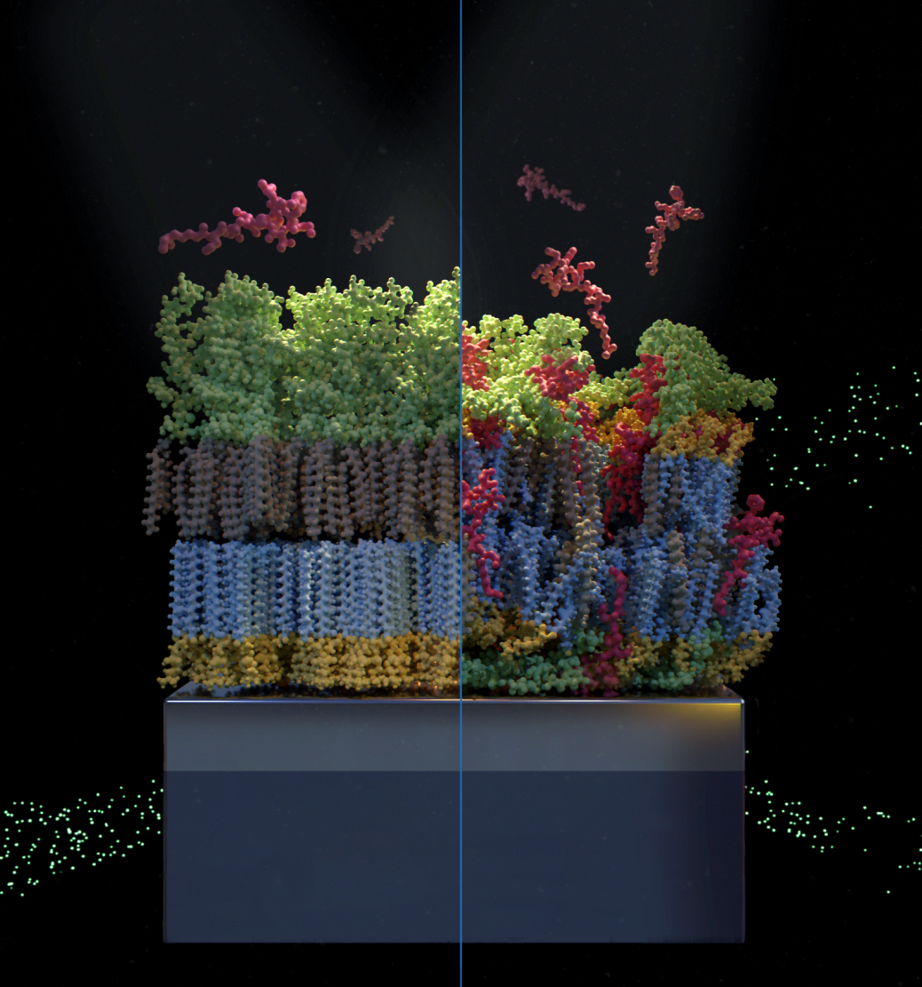

Slide 3
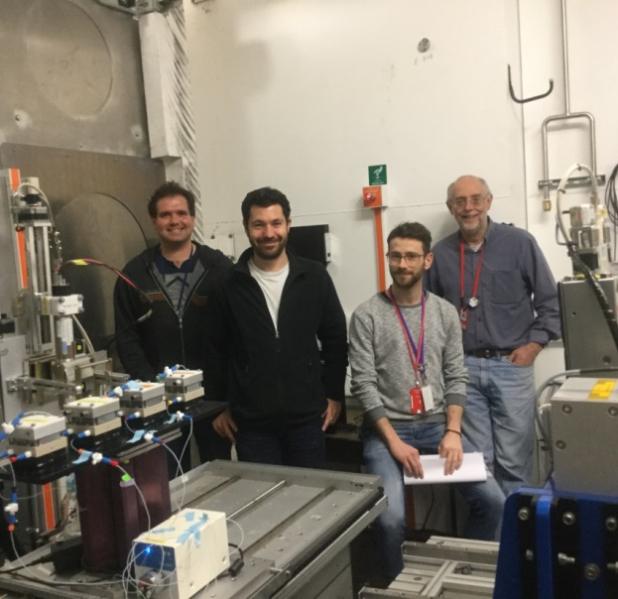
Acknowledgements
Jeremy Lakey, Newcastle University
Max Skoda, ISIS
John Webster, ISIS
Willem van Schaik, Birmingham University
Christy Kinane, ISIS
Tim Charlton, ORNL, USA
Nicoló Paracini, Newcastle/ ISIS
Richard Frazier, Reading University
Rebecca Green, Reading University
Mark Sansom, Oxford University
Laura John, Oxford University/ISIS
Andy Church and SE team, ISIS
Frank Heinrich, NIST, USA
Filip Ciesielski

Slide 4
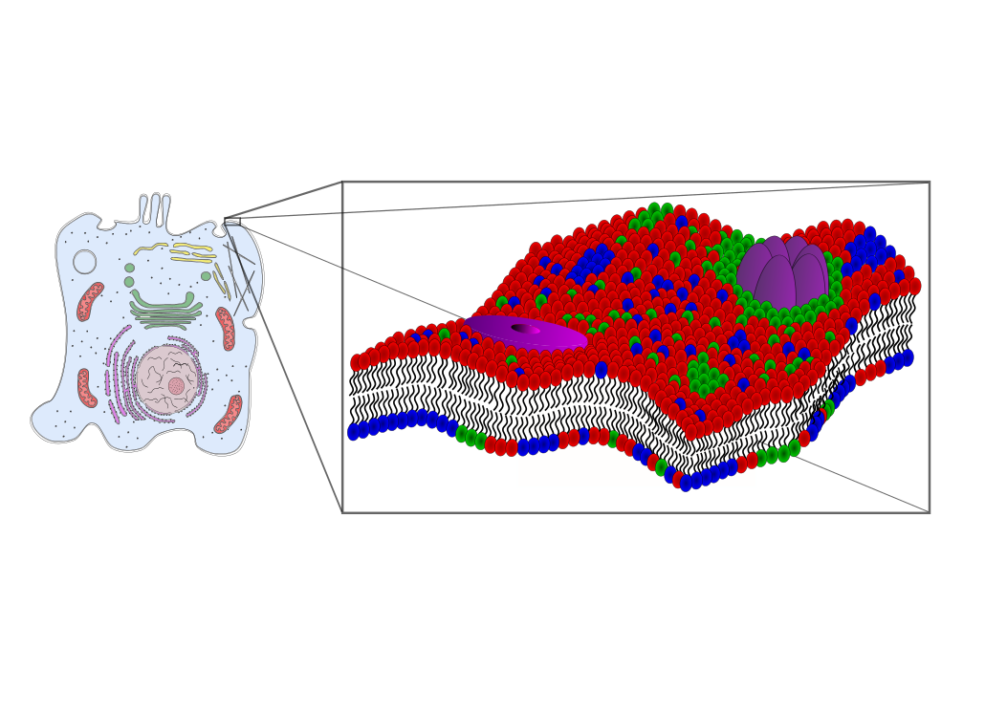
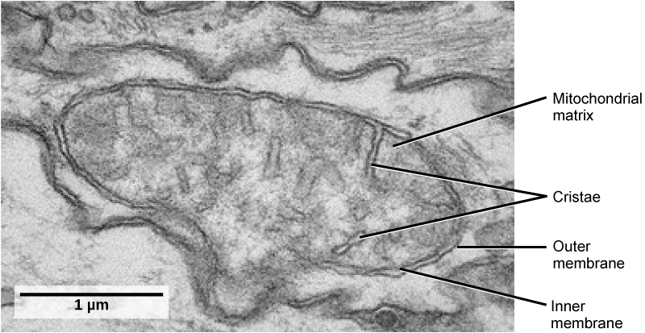
Real Membranes : Difficulty in Obtaining Precision Molecular Information

Slide 5
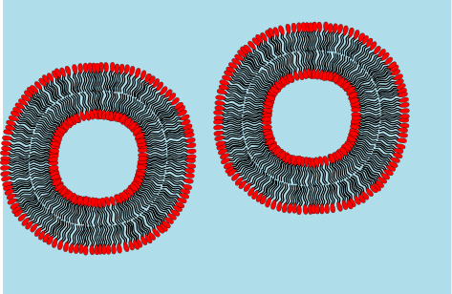
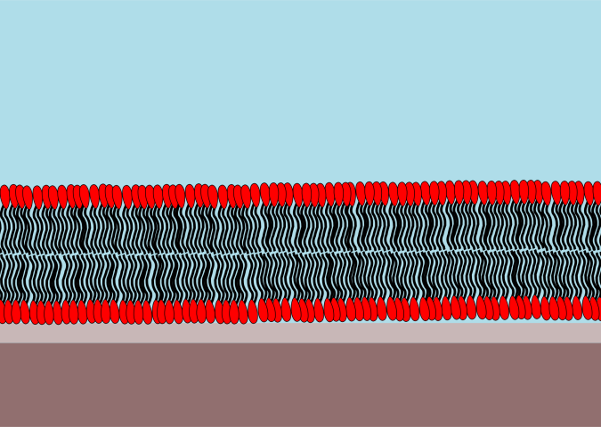
Model Membranes : Allow for Precision
Monolayers
Vesicles
Supported Lipid Bilayers

Slide 6
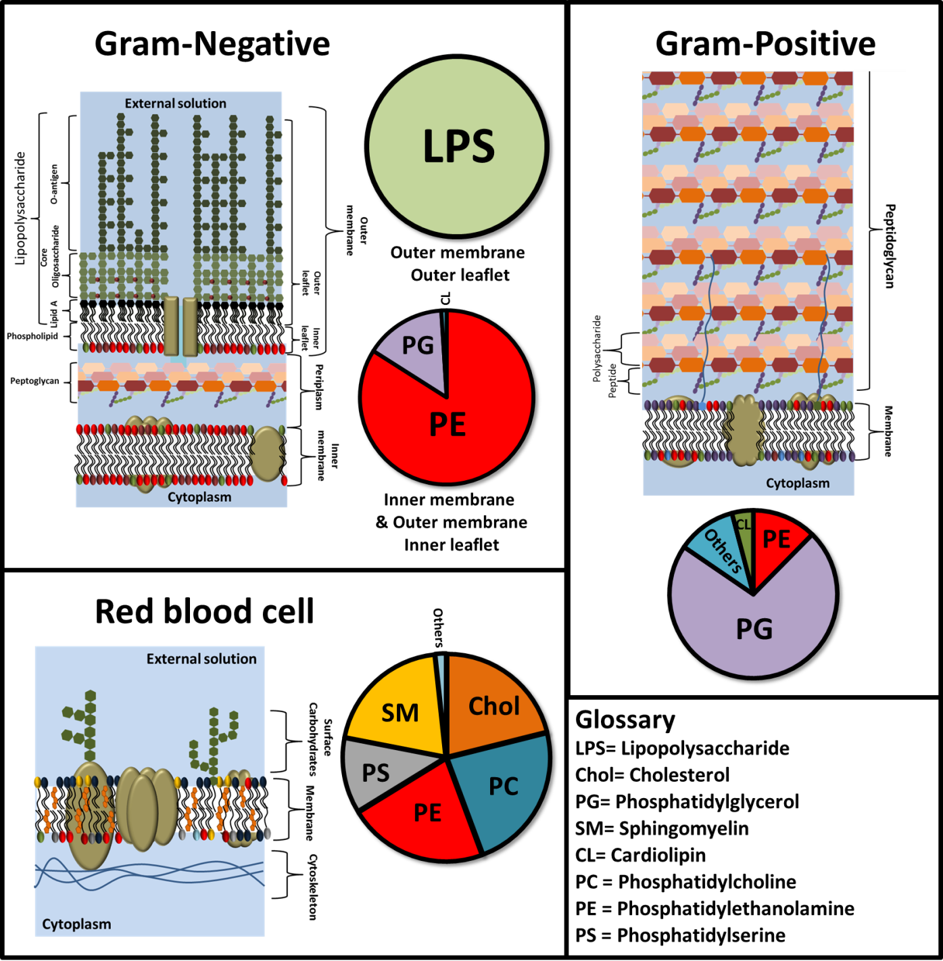
But Remember Accuracy

Slide 7
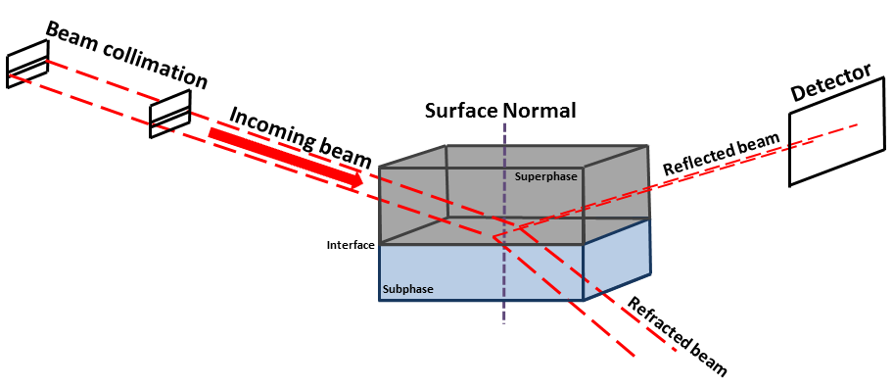
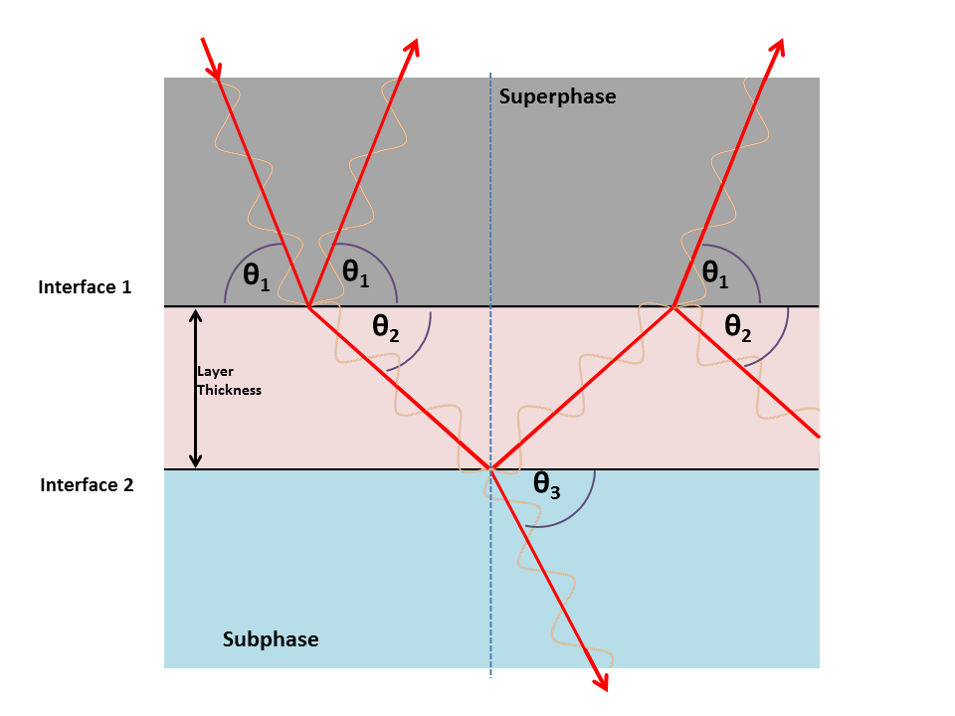
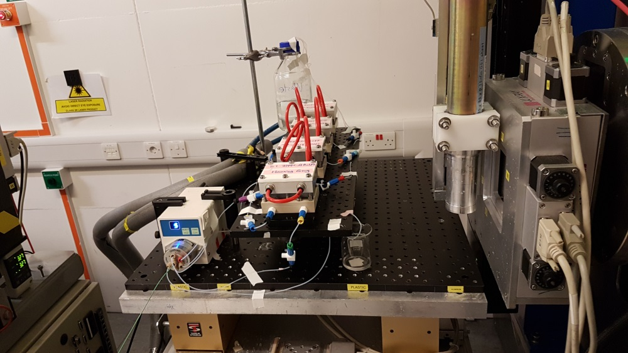
Neutron Reflectometry
Clifton et al, 2019, Lipid-Protein Interactions, Methods in Molecular Biology, 201-251

Slide 8
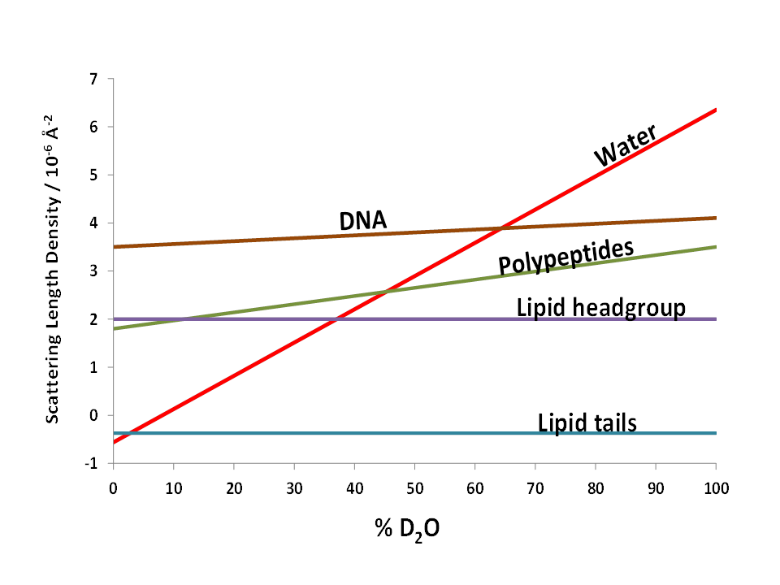
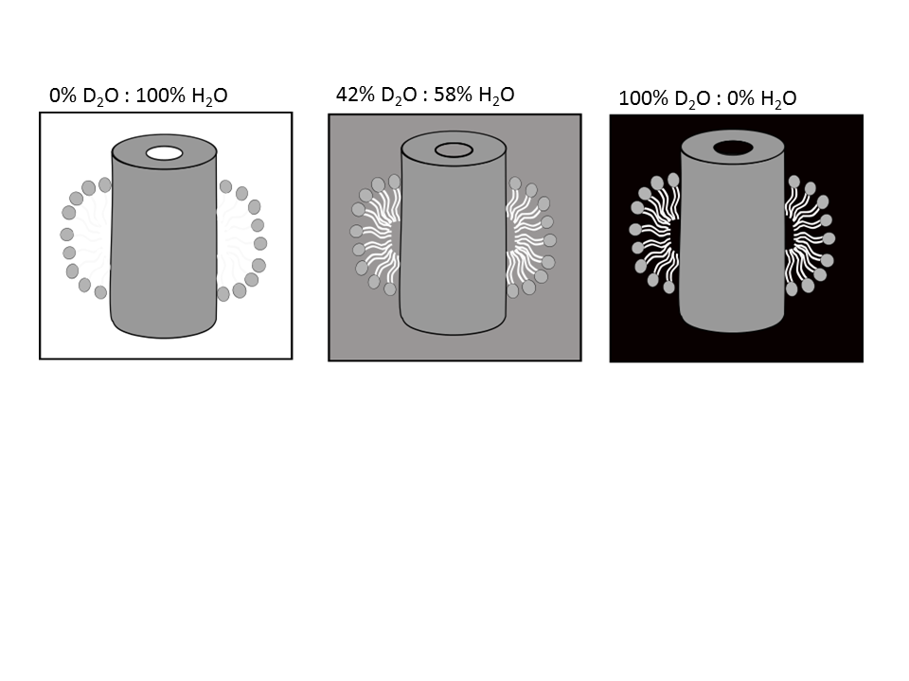
Isotopic contrast allows for Individual Components to be Identified amongst Complex Samples
Element | Scattering Length (b)/ 10⁻⁵ Å
Hydrogen (99.98% protium) | -3.74
Deuterium | 6.671
Carbon | 6.646
Nitrogen | 9.36
Oxygen | 5.803
Sulphur | 2.847
Phosphorus | 5.13

Slide 9
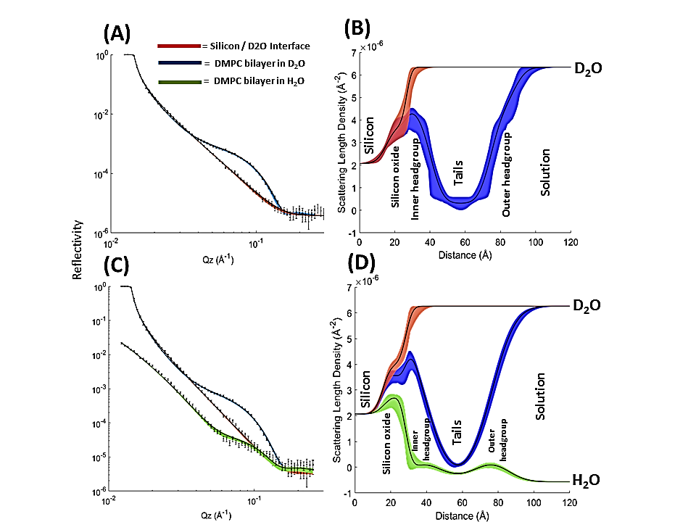
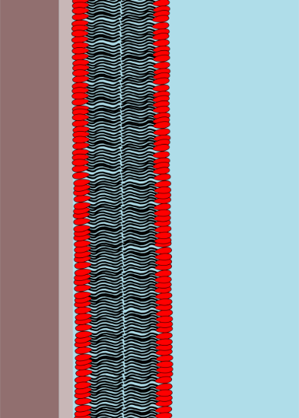
Isotopic contrast allows for Individual Components to be Identified amongst Complex Samples and For a Reduction in Ambiguity
Clifton et al, 2019, Lipid-Protein Interactions, Methods in Molecular Biology, 201-251

Slide 10
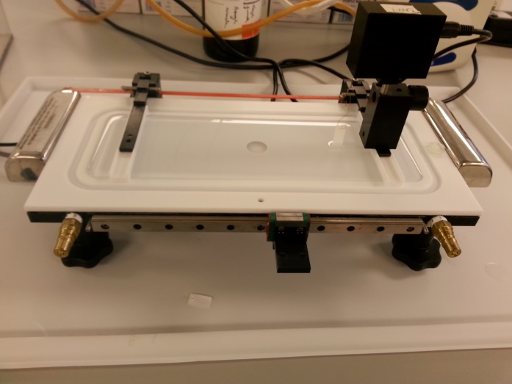
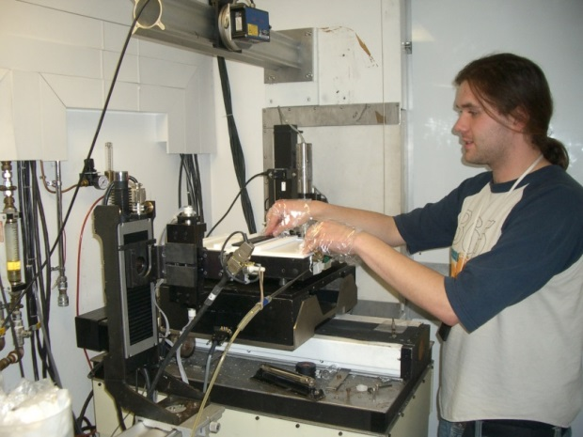
Modelling Membrane Relevant Interactions : Where I started

Slide 11
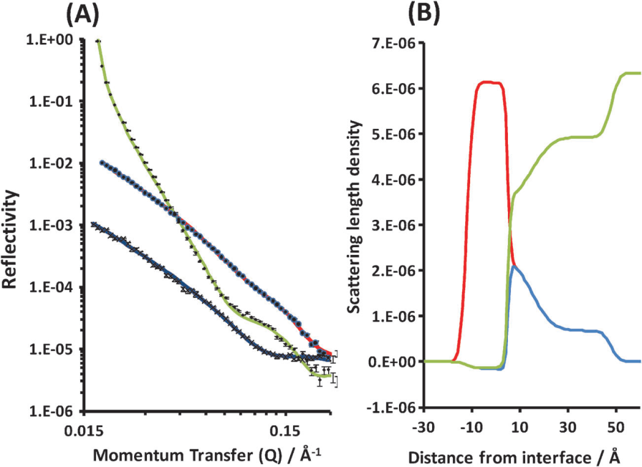
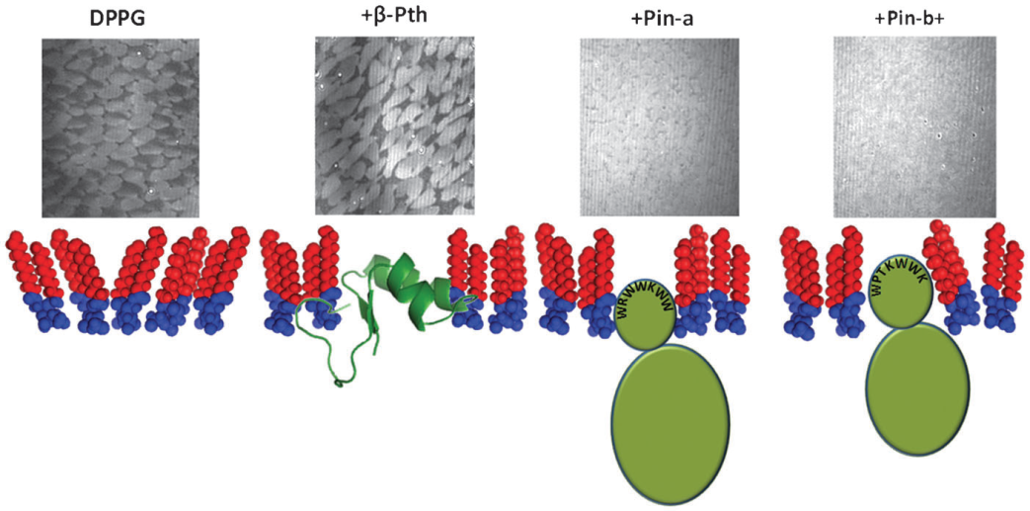
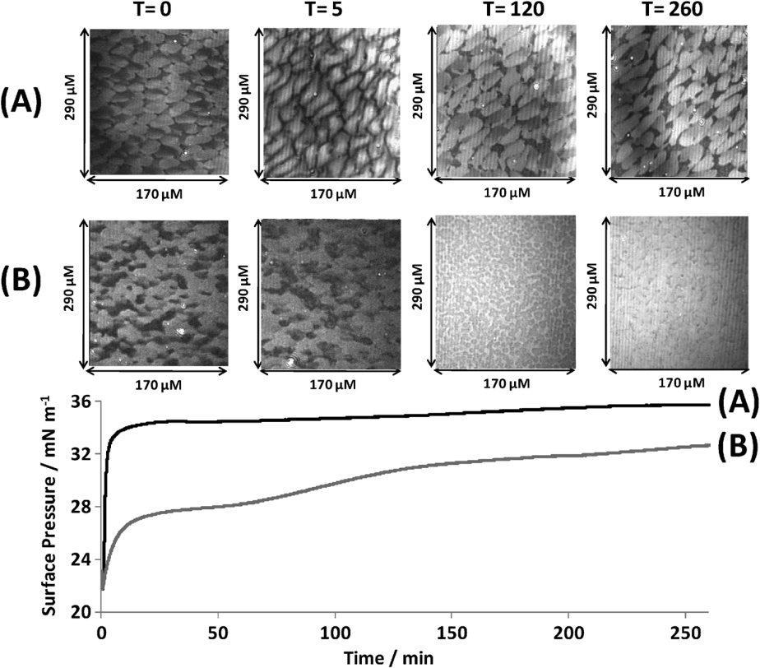
Seed Defence Protein Interactions with Simple Model Membranes
D₂O
ACMW
Clifton et al, PCCP, 2011, 13, 17153-17162

Slide 12
I want Precision and Accuracy in Model Membrane Studies

Slide 13
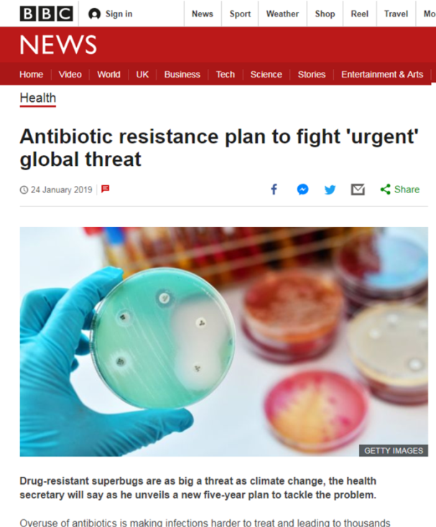
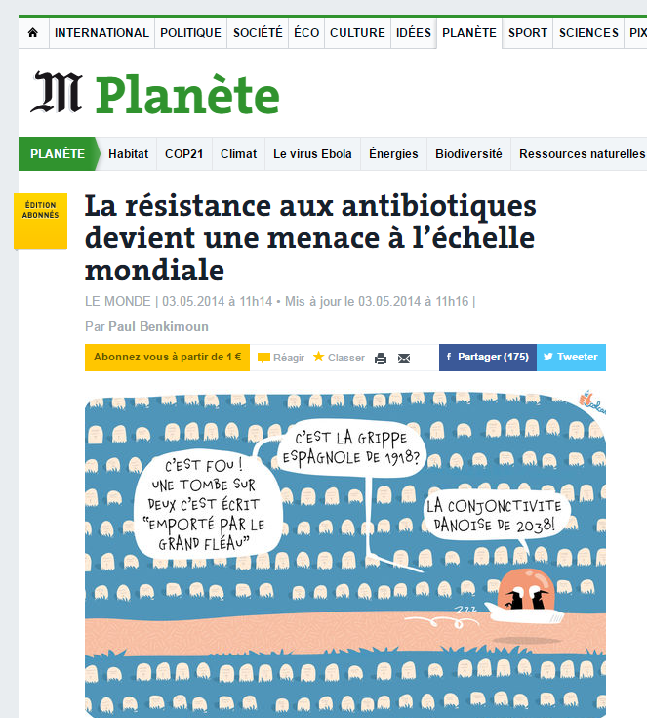
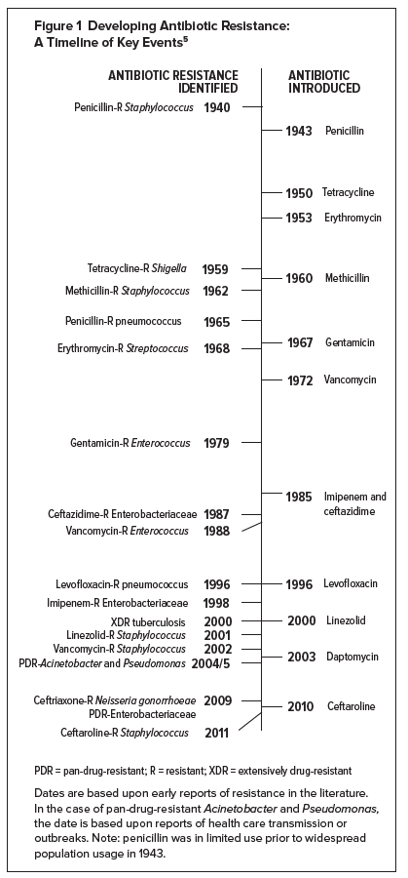
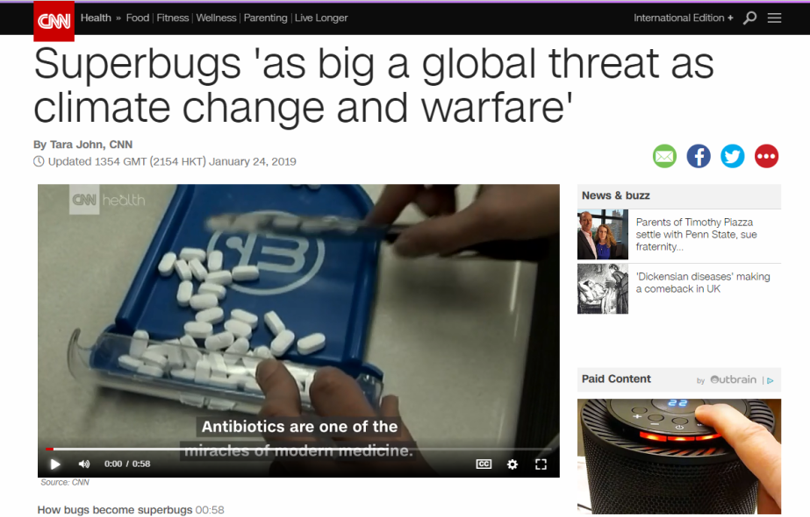
Bacterial Outer Membrane Binding Assays
Lee Vontana, P&T, 2015 40, 4

Slide 14
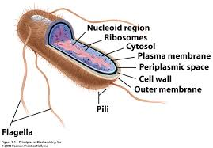
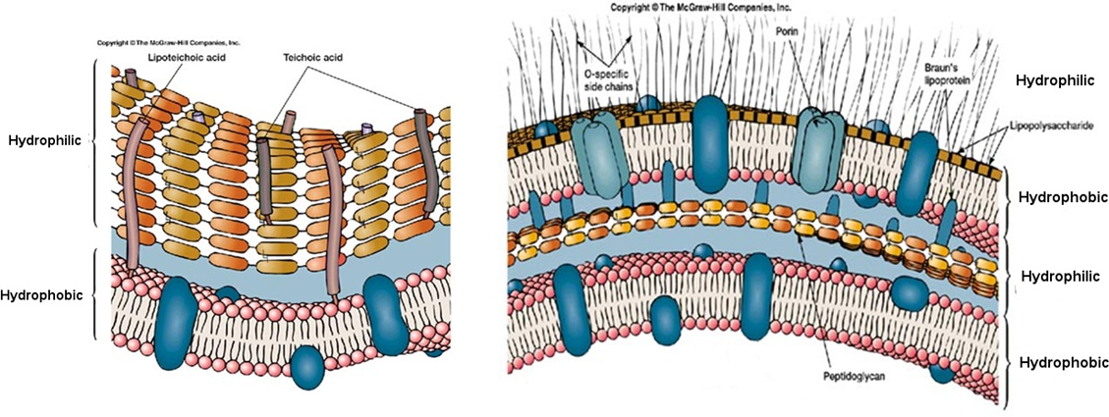
Bacteria
Gram positive
Gram negative

Slide 15
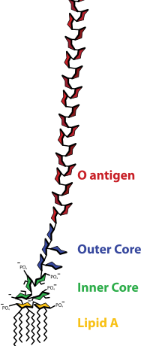
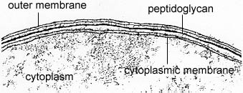
Build Accurate Models of the Gram Negative bacterial Outer Membrane Suitable For use in Structural Studies on the OM

Slide 16
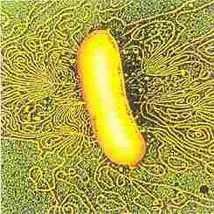
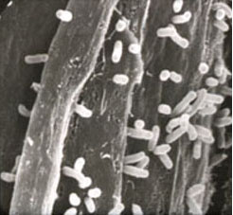
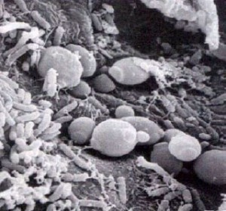
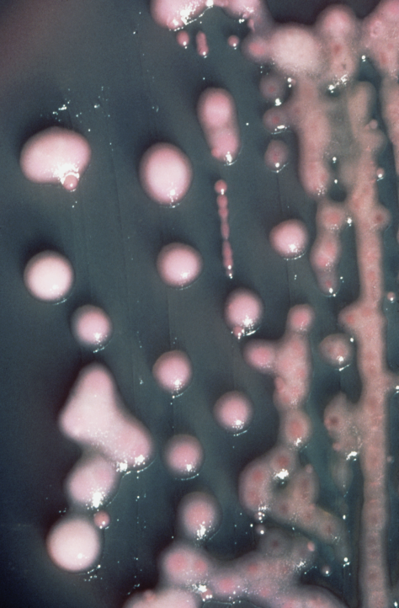
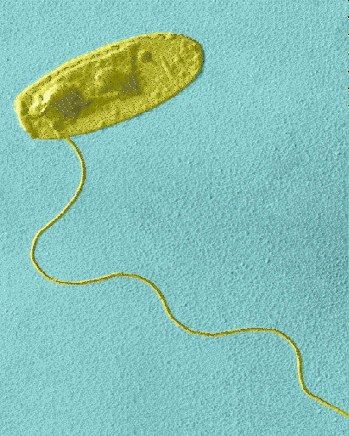
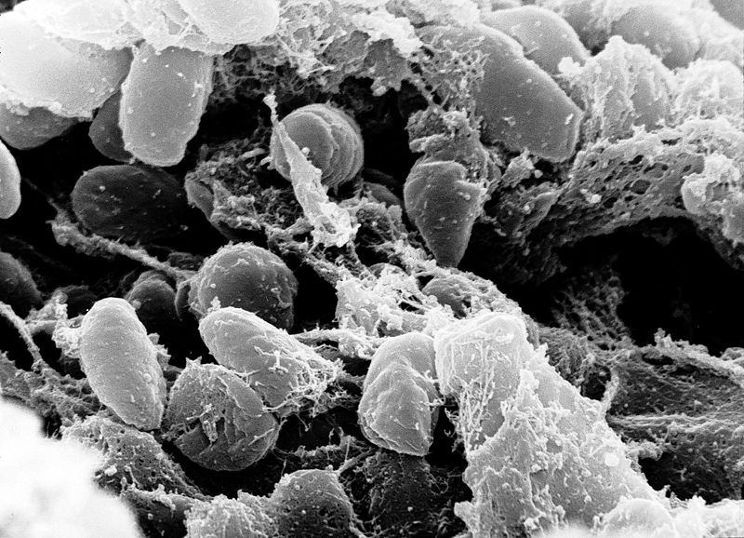
Gram Negative Bacteria : the good and the bad
Recombinant
E. coli
Rhizobium
Gut microflora
Yersinia pestis
Legionella
Klebsiella

Slide 17
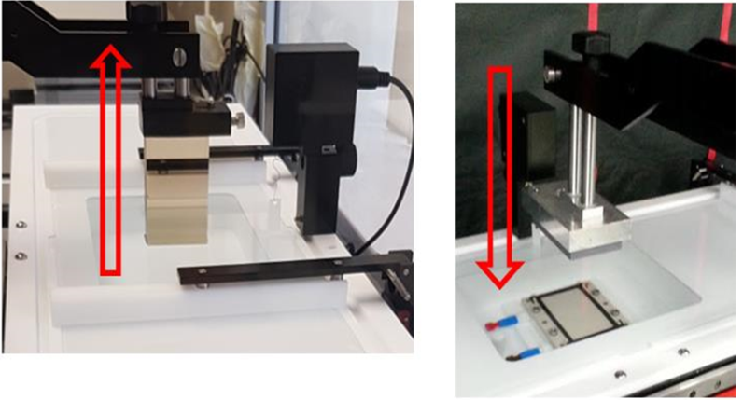
Fabrication of asymmetric phospholipid : LPS membranes
on silicon supports
Silicon
Silicon
+
=
Silicon
Langmuir Blodgett
Langmuir Schaeffer
Si crystal
Neutrons
LC pump
Peek trough
Waste
Clifton et al, J. R. Soc. Interface 2013, 10, 20130810.

Slide 18
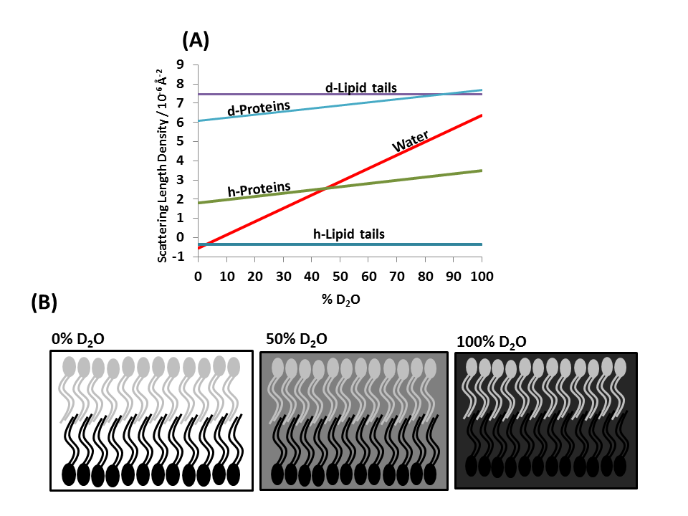

Slide 19
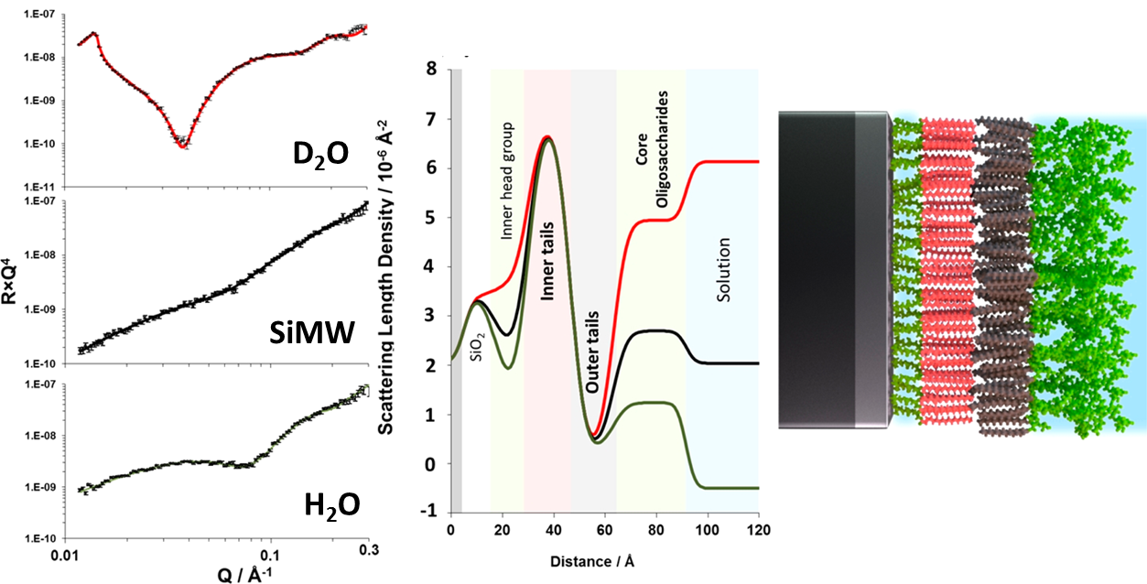
Silicon Supported Model Gram Negative Bacterial Membranes : Data
D₂O
SMW
H₂O
Development and use of this system can be found in:
Clifton et al, Journal of the royal society interface, 2013, 10 (89), 20130810
Clifton et al, Langmuir, 2015, 31, 1, 404-412.

Slide 20
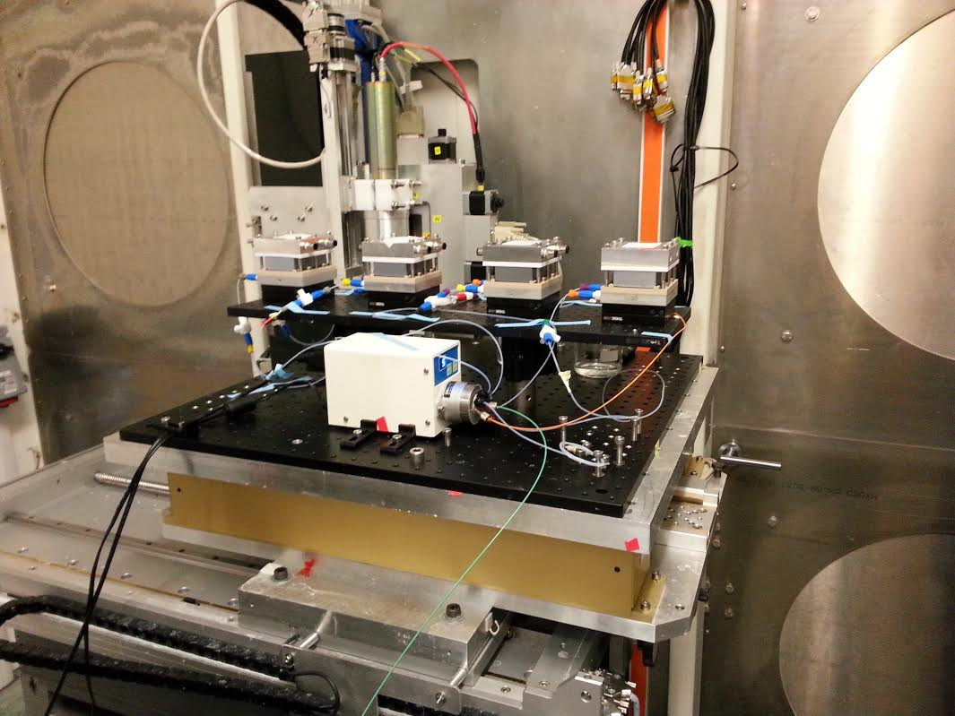

Slide 21
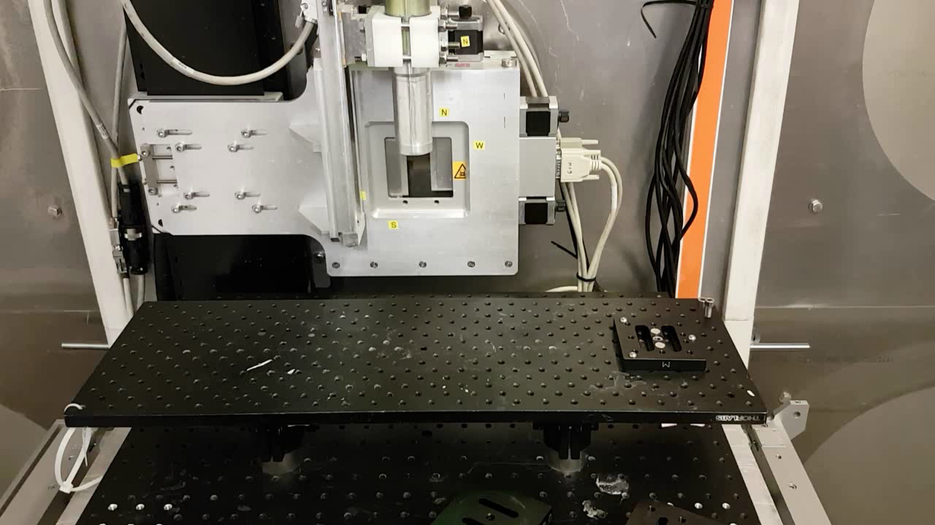

Slide 22
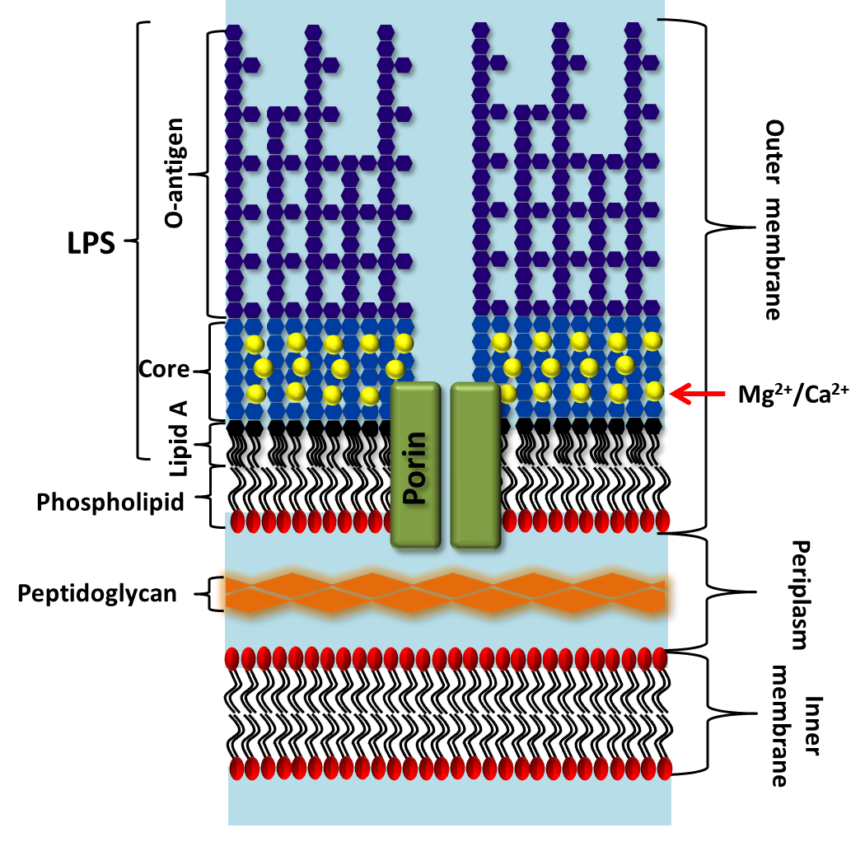
The effect of Divalent Cation removal on the Structure of the Gram negative OM

Slide 23
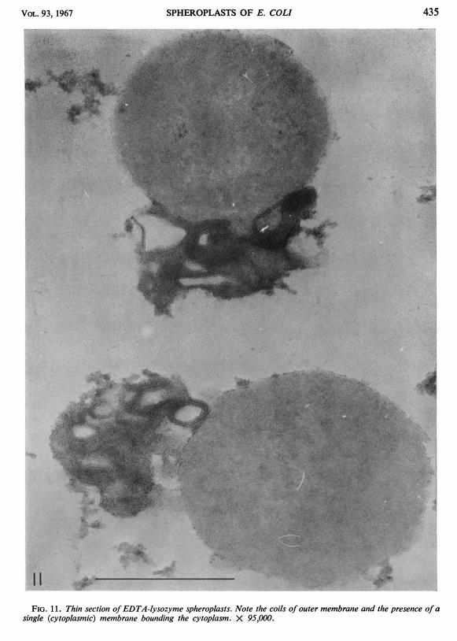
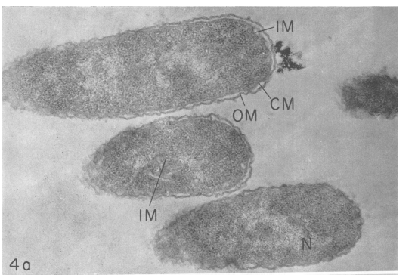
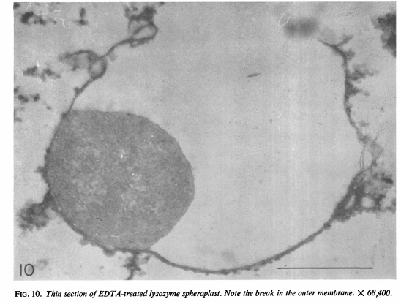
Birdsell and Cota-Robles, J Bacteriol, 1967, 93, 1, 427-437.

Slide 24
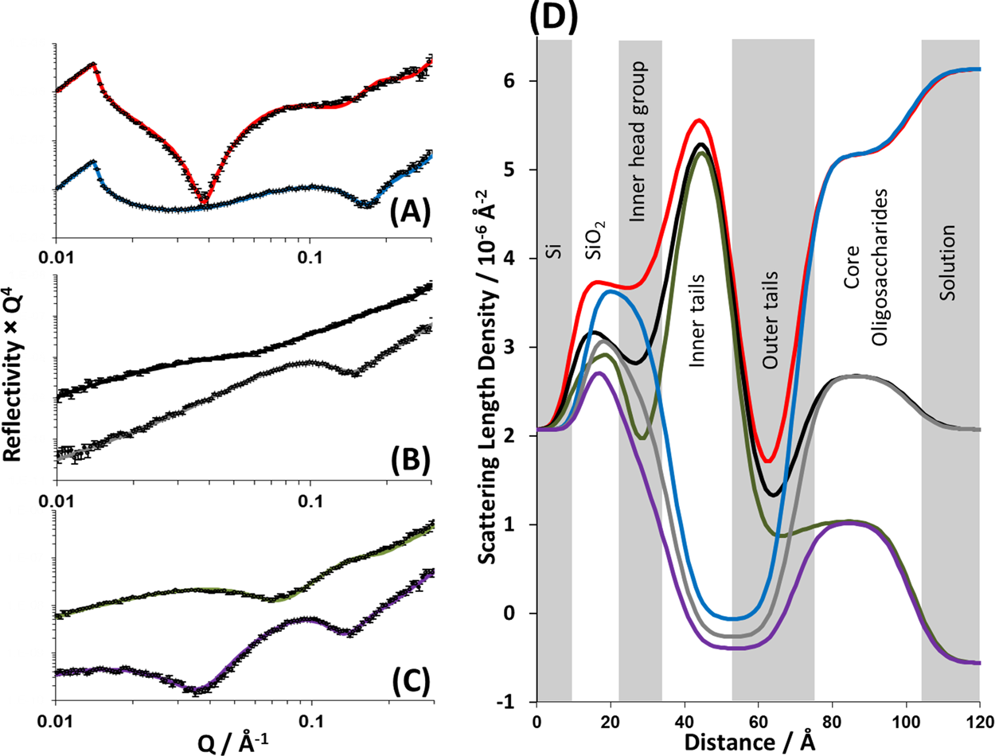
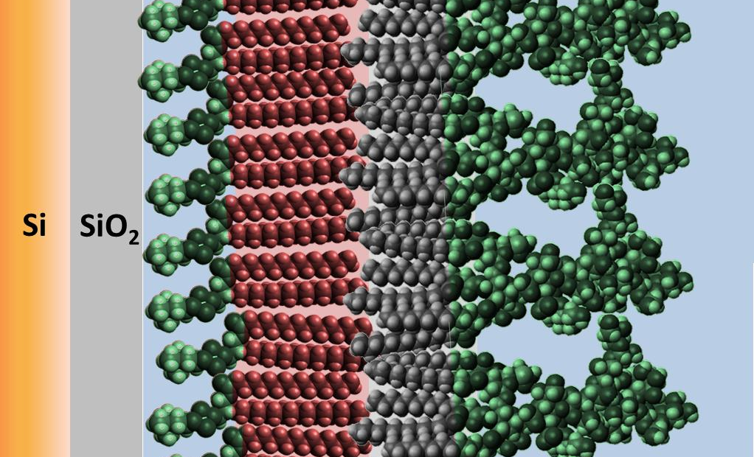
Asymmetric DPPC (inner leaflet) : Ra-LPS (outer leaflet) bilayer deposited
on Silicon in Ca²⁺ buffer

Slide 25
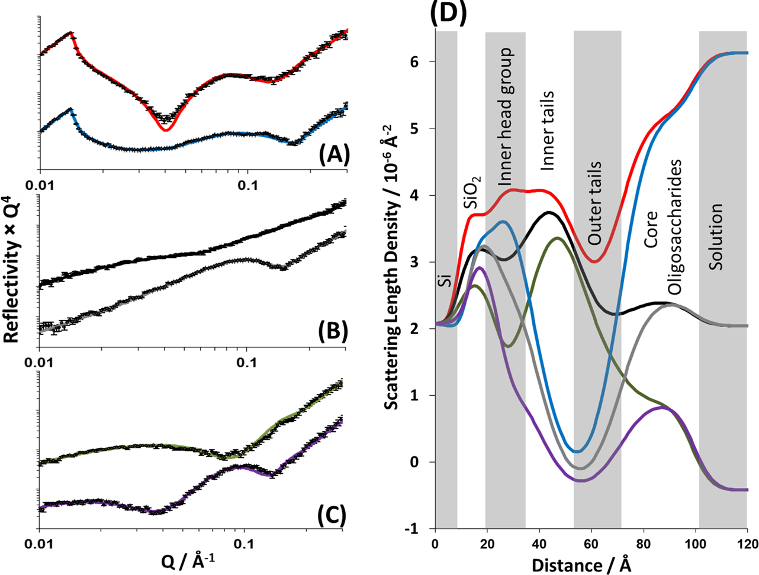
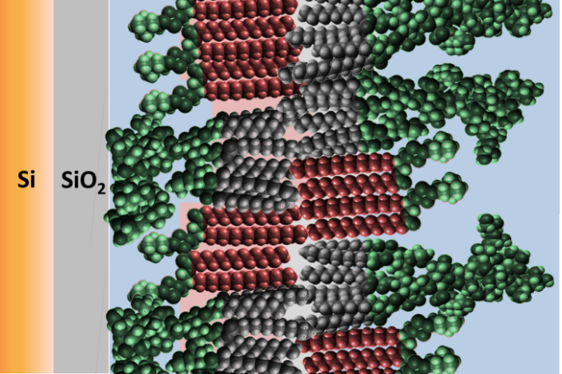
Asymmetric DPPC (inner leaflet) : Ra-LPS (outer leaflet) bilayer deposited
on Silicon in EDTA containing buffer

Slide 26
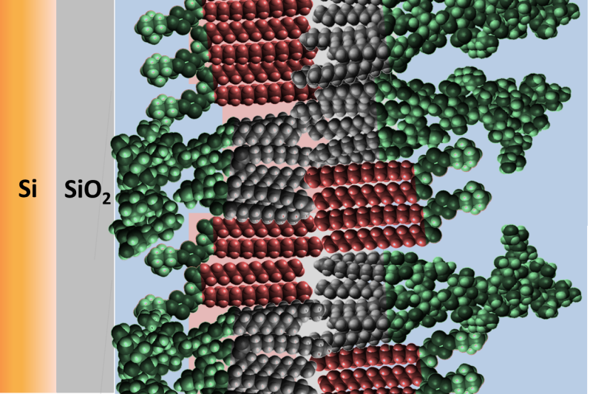

SiO₂
Outer tails
Core
oligosacharide
- Ca²⁺
Solution
Inner tails
Inner head group
Si
5 mM Ca²⁺
3 mM EDTA
Clifton et al, Langmuir, 2015, 31, 404-412.

Slide 27



The Role of Uncharged Sugar groups in the Core in Defending the Bacterium from Antibiotics
Clifton et al, Langmuir, 2016, 32, 3485-3494.

Slide 28


Lipopolysaccharide Phase is Key to Colistin Disruption of the OM

Slide 29



Lipopolysaccharide Phase Determines Antibiotic Susceptibility

Slide 30

Paracini et al, PNAS, 2018, 72 (12), 1227-1240.

Slide 31
Break Here

Slide 32

Advanced membrane Mimetics
Polymer Cushioned Bilayers
$$Substrate Influence∝\frac{1}{Distance}$$
Tethered Bilayers
Floating Bilayers

Slide 33




Floating Model Gram Negative Bacterial Membranes
Si
Py
Au
Solution

Slide 34

Floating Model Gram Negative Bacterial Membranes : Fabrication

Slide 35


Floating Model Gram Negative Bacterial Membranes : Data
Development of this system can be found in:
Clifton et al, Angew. Chem. Int. Ed. 2015, 54, 1 – 5
Hughes et al, Biophys J, 2019, 116, 1095-1104

Slide 36


Antimicrobial protein interactions with the OM
Lysozyme
pI 11.35
Lactoferrin
pI 8.7

Slide 37

Floating Model Gram Negative Bacterial Membranes : Interaction Studies
Lactoferrin
Distance / Å

Slide 38
Floating Model Gram Negative Bacterial Membranes : Interaction Studies
Lysozyme

Slide 39



Non-mutated bacterial Model
PmB resistant mutant
bacterial Model

Slide 40


FSB interpretation with MD Simulations
Hughes et al, Biophys J, 2019, 116, 1096-1106

Slide 41

Advanced Self-Assembled ~Planar Floating Membranes.

Slide 42

Self-Assembled fluid phase Membrane with ~1nm solution Interlayer between the SAM and
Membrane

Slide 43




Electrolytes Change Membrane to surface distance – Reversibly!
0 mM NaCl (return)
0 mM NaCl
200 mM NaCl
100 mM NaCl
D₂O
D₂O
D₂O
HG
HG
HG
HG
D₂O
HG
HG
HG
HG
AuMW
AuMW
AuMW
POPC Tails
AuMW
POPC Tails
COOH-SAM
POPC Tails
COOH-SAM
POPC Tails
COOH-SAM
COOH-SAM
Scattering Length Density / Å⁻²
Gold
Gold
Gold
Gold
Solution
Solution
Solution
Water
Solution
Water
Water
Water
H₂O
H₂O
H₂O
H₂O
Distance / Å

Slide 44



I
II
III
Reflectivity × Q⁴
IV
Q / Å⁻¹

Slide 45



Two viable Mechanisms explain observed results – one known for surfaces another for lipids
+ NaCl
?
Secondary Hydration
Forces
Petrache et al, PNAS, 2006, 103, 21
Parson et al, PCCP, 2011, 13
Figure 2, Potential Differing Mechanisms which cause increased bilayer to surface distance.

Slide 46

A New Self-assembled Floating Membrane System with Tuneable Aqueous Interlayers
Clifton et al. (2019): Self-Assembled Fluid Phase Floating Membranes with Tuneable Water Interlayers. ChemRxiv. Preprint.

Slide 47

Thank you for listening

